Slide 1
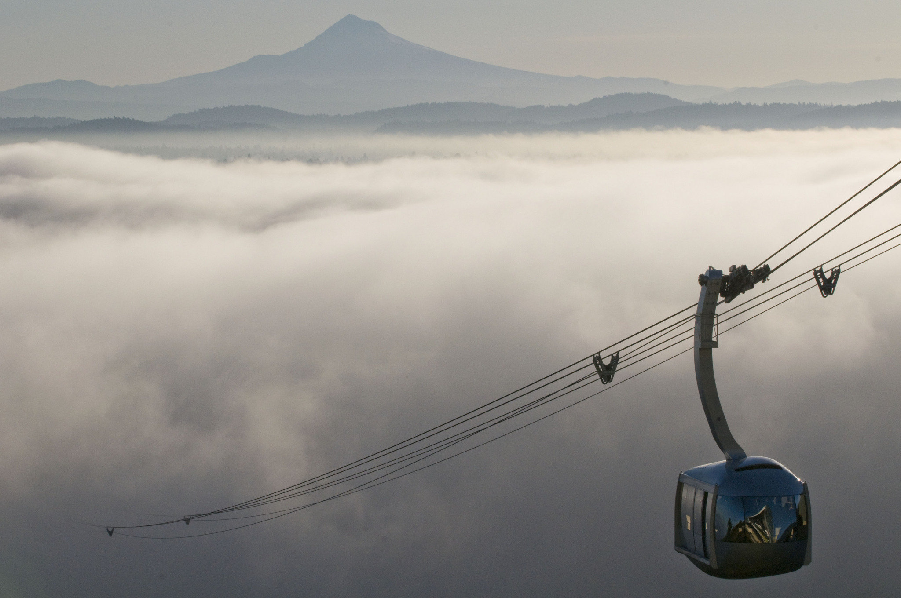
Building Data-Centric Relationships with Research Scientists
Research liaison & data management services to a research community at an academic health sciences university
Photo:Brent Wojahn
Notes:
Hello!
Thank you Stephanie for the kind introduction. I have had a great time so far getting to know Library faculty and staff, and I look forward to talking to more of you after this presentation.
As Stephanie said, I am about to finish my PhD training.
wide variety of experiences at the bench including work collecting and analyzing many types of data
from high volume EM, to superresolution microscopy, molecular biology, genetics, proteomics, and studying neural circuitry
I’ve dealt analysis of protein expression and gene expression
My background helps me to understand the specific needs and challenges of both small and large data sets.
But why am I here today? Throughout my training I have always worked to advance science through collaboration, building relationships, discussion of big picture issues in research and policy at the institutional level.
Libraries are shaping and advancing practice of science and polices that affect researcher at institutions across the country, and this is the work I want to be involved in so I am thrilled to get the chance to talk to you today
about Basic Sciences Liaison liaisonship and research data management services
opportunities and challenges that are specific to Academic Health Sciences campus.
I’ve titled the talk “Building data-centric relationships with Research Scientists” because effective liaison services – and the reach of library data management services - are both dependent on building and maintaining quality relationships with researchers.
DON’T TALK TOO FAST

Slide 2
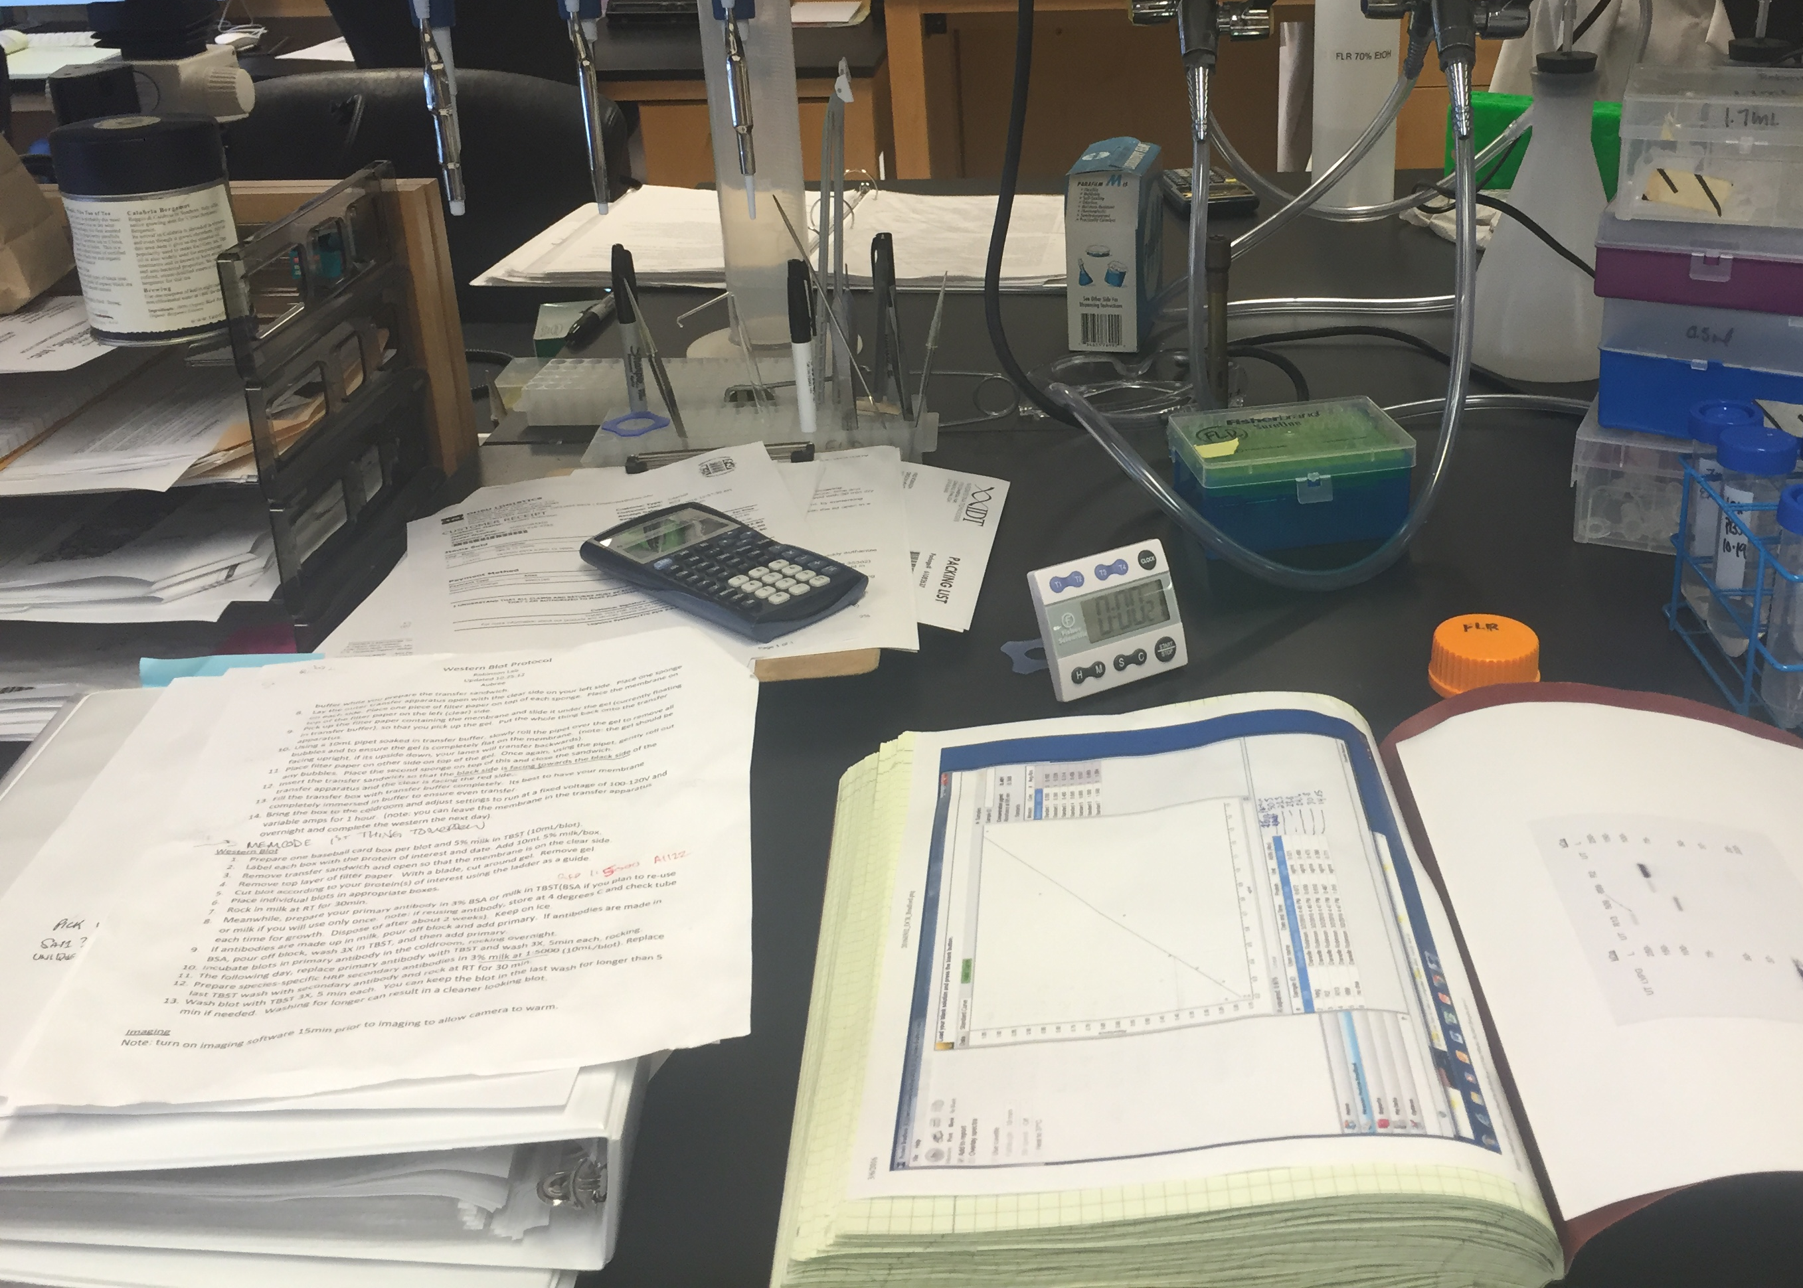
Building Data-Centric Relationships with Research Scientists
Landscape
Challenges
Vision
Case studies
Action plan
Notes:
Landscape:
I’ll start with a brief discussion of the larger landscape where Research Data Management and Library Liaison are nationally
Touch on the specific academic health sciences research culture of OHSU
And they role of the librarian in the research and data lifecycle
FOLLOWED that, I will bring up some of the challenges associated with meeting our researchers where they are
– making the initial connection and building relationships that allow for anticipation of needs –
getting them where they’re going with effective educational programming, connection to resources.
And finally I will lay out a vision that addresses our specific needs
with discussion of some case studies,
And then lay out my action plan

Slide 3
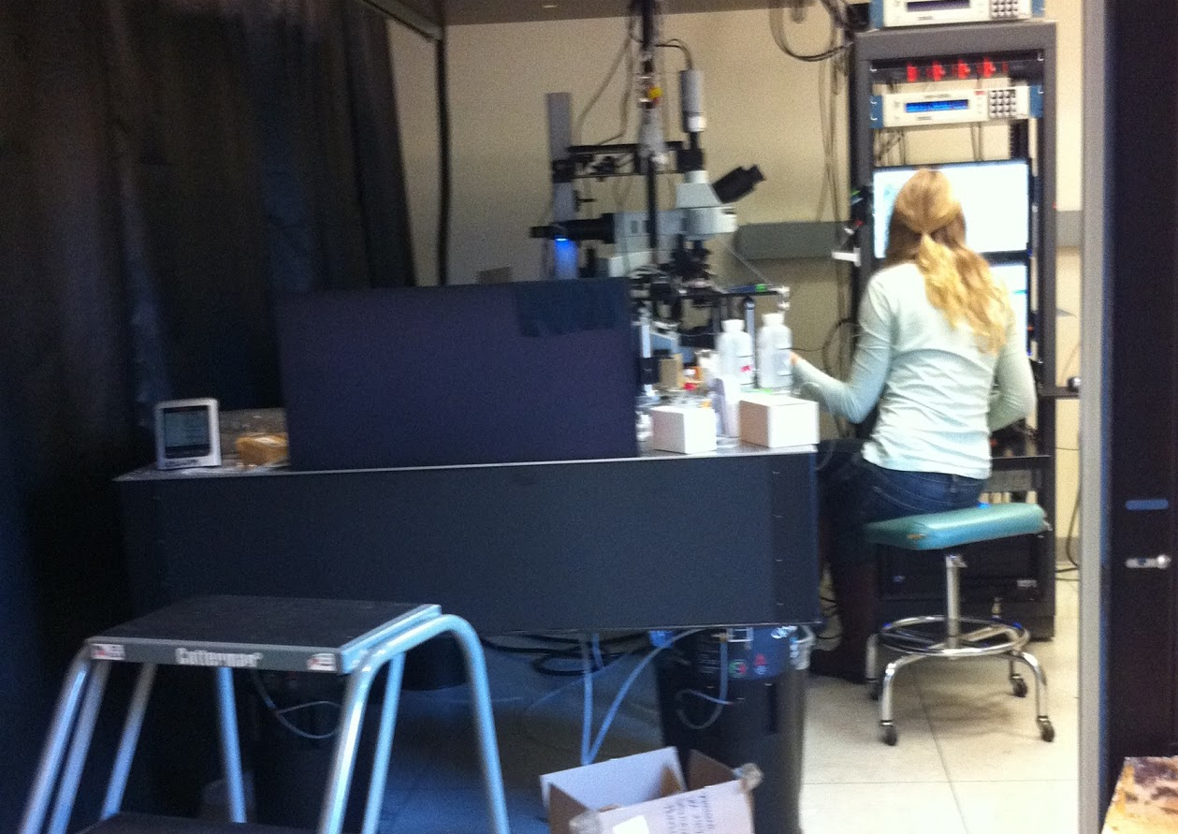
Landscape: Science changes quickly, Libraries respond with support
Tools
Software
Complexity
Lab ecosystem
Follow the science
Notes:
So let’s start broadly. Science changes fast. And as it does, institutional libraries are responding with support and a greater role in the research process…
New tools are constantly being developed and adopted, existing tool are always being refined,
The software landscape is completely different than it was five years ago, and the open source movement makes collaboration easier than ever, and increases the need for digital literacy
Nearly every field is expereincing an increase in complexity, as researchers apply new tools to follow their questions
But it’s more than just methods, tools, questions, and fsoftware that are changing.
Labs are always changing - Students and postdocs cycle through labs. Volunteers and undergraduates make research contributions.
THE LAB IS A CONSTANTLY CHANGING ECOSYSTEM.
Researchers are always innovating, always pushing, always following the science.
As Researcher generatemore data, and new types of data, researchers digital literacy and data management practices have not always kept pace.

Slide 4
Landscape: Library liaison and data management services are evolving
Understand and anticipate needs (UNC Provost’s Task Force Report, 2012; Carlson et al., 2011)
Collaborating on policies (Dyke & Hubbard, 2011; Briney et al., 2015)
Educational programs and research data management courses/services (Whitmire 2014, 2015; Rolando et al., 2015; Carlson et al. 2013)
Skill and tool instructional support (Iwema @ Pitt; Wright @ UW)
Notes:
At institutions across the country,
libraries are working to deeply understand the needs of researchers of all kinds, there are many published preorts describing the cliate at specific institutions.
Libraries as the information and data experts on campus are collaborating on institutional policies .
Students come to PhD programs with viraible levels of expereince dealing with data and the faculty noted a lack of DEEP TRANSFERRABLE SKILLS in their students, and Faculty acknowedge need for RDM training
Libraries responding by devloping educational programs, and providing skill and tool instructional support - but there’s no consensus on what works.
Ideally, this this support enables researchers to develop substantive, transferrable knowledge of research data management best practices
(Carlson et al., 2011; UNC Provost’s task force 2012; Schaffer, 2013; Ferguson, 2013 )
“Standards, ontologies, communities of practice” (Schroeder, 2013)
http://news.berkeley.edu/wp-content/uploads/2015/12/sciencecover.jpg
https://www.janelia.org/open-science/advanced-imaging-center-aic
http://www.thestar.com/content/dam/thestar/news/insight/2015/12/28/the-crispr-scientists-who-are-altering-genetic-history/mice-used-at-jackson-lab-for-anch.jpg.size.xxlarge.promo.jpg
http://www.aureliabio.com/capabilities/high-throughput-screening/

Slide 5
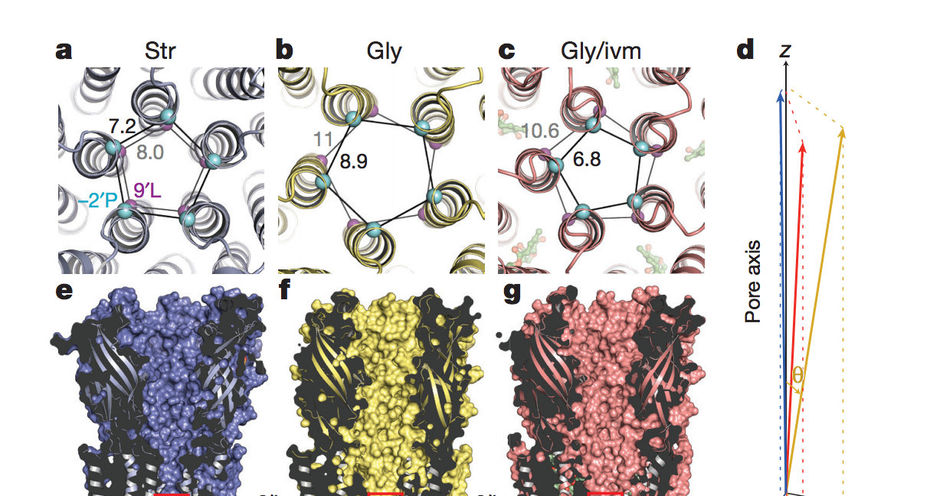
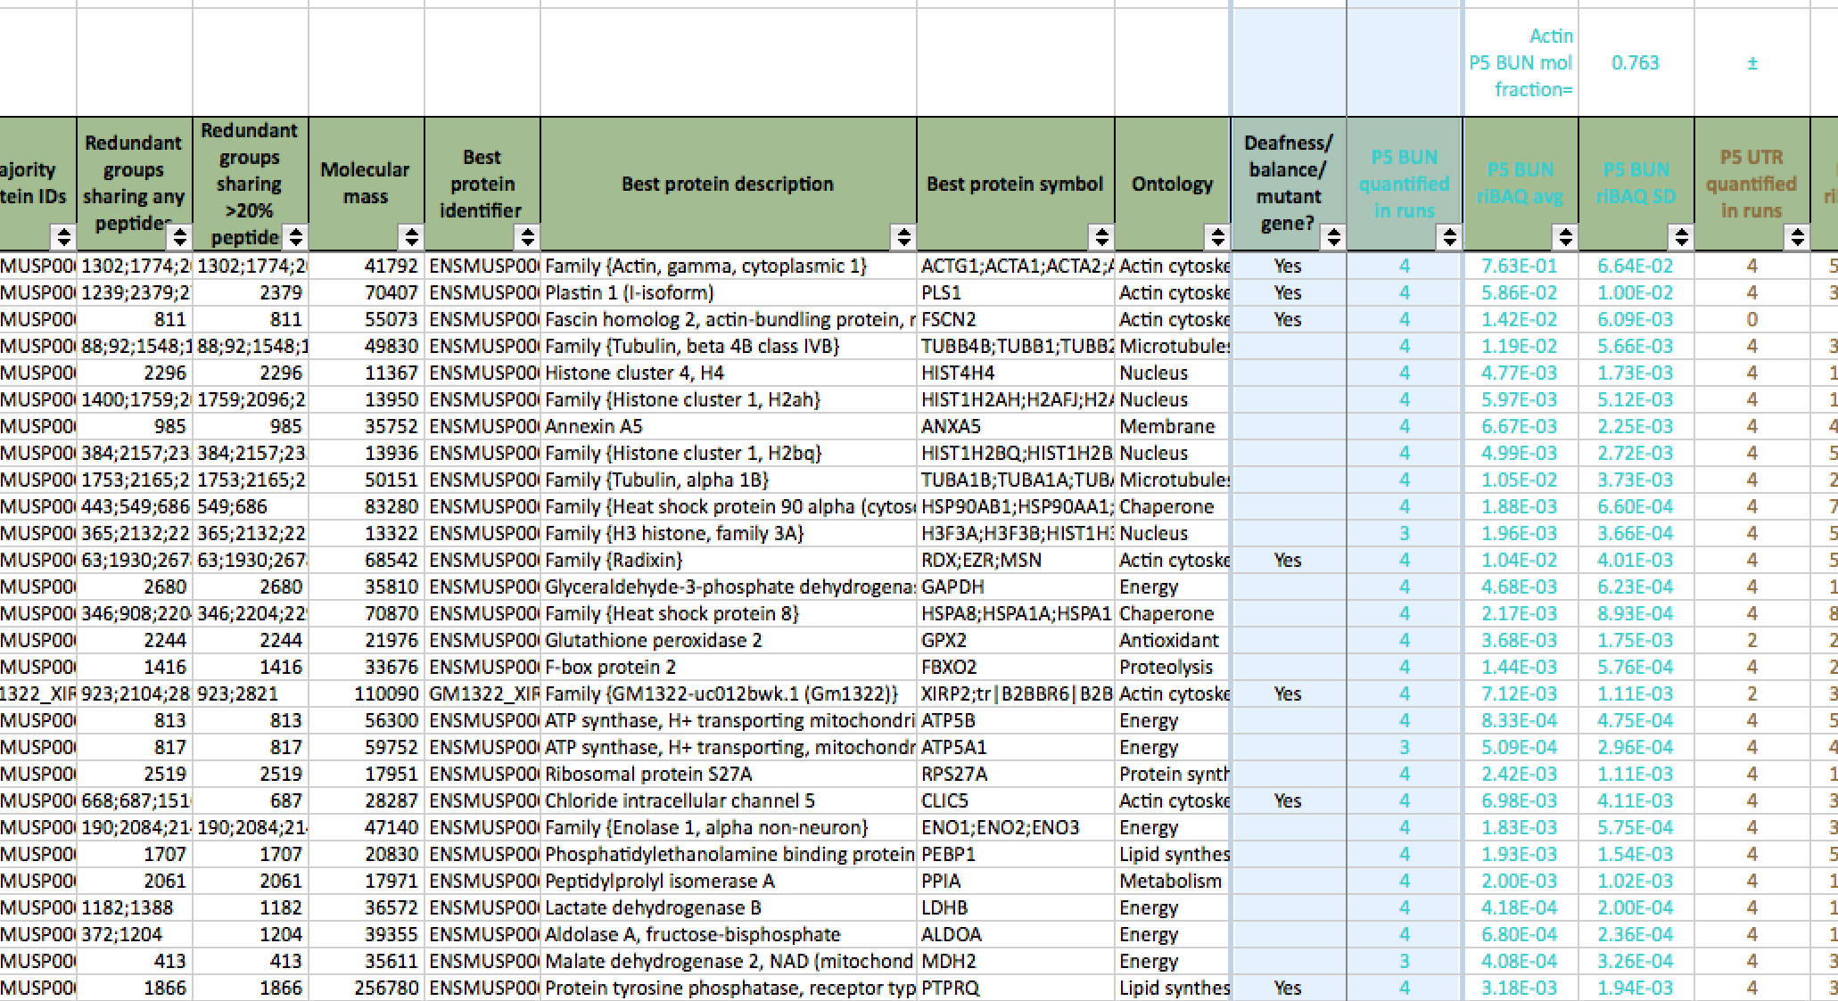
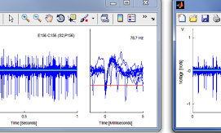
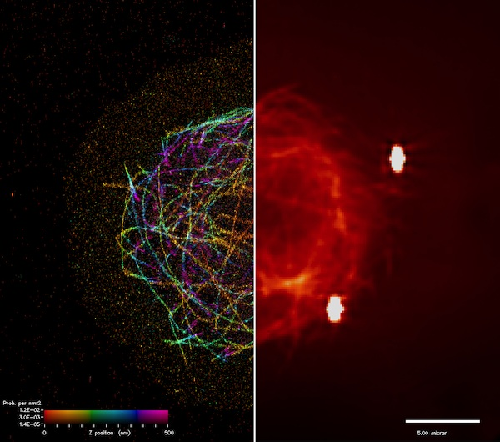
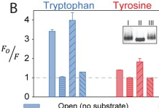
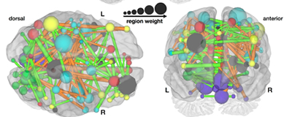
Landscape: OHSU researchers have diverse data support needs
Gouaux Lab
Barr-Gillespie Lab
David Lab
Galbraith Lab
Farrens Lab
Fair Lab
Knight Cancer Center, Vollum Institute, Casey Eye institute, Jungers Center for Neursciences Research, OCSSB & OHSU/FEI Multiscale Microscopy Core, the new Center for Radio Chemistry Research, and many core facilities
Notes:
Here are just some of the diverse data types that our labs work with
Gaouax lab – cryo-EM and protein crystallography data sets
Gillespie lab – Proteomics data sets
David Lab – records electrical signals form the brain and builds custom software to collect and analyze these data
Galbraith lab – superrresolution micrscopy – 10s of thoursands of frames that need to be heavily processed to creat a single image
Farrens Lab – quantitative fluorescence lifetime data
Fair Lab – fMRI data that is usec to develop complex interaction maps
… and that’s just six labs spanning single protein structure at the atomic scale to human subjects
Beyond individual labs, there are multi-lab centers where researchers collaborate and connect, and come of these centers host technical cores with their own data needs.
Our research culture priotitzes collaboration, collegiality, ivvovation, and of course excellence
– but it’s better than that – they show up – Research week, data jamboree, Open Insight events, Vollum Friday Seminars, to OHSU Library stratgic planning –
they priotitize learning, innovation, dicsvery, and they want the best tools and resources to get them there
And because of that, we in this room are positioned to make a big impact as we roll out rsearch dat manament services to this communty.
So let’s start broadly. Science changes fast.
WHITMIRE AND ET AL TYPOS
BROADER SCIENCE PICS
CHOOSE 1 OR 2 TO
New tools are constantly being developed and adopted, existing tool are always being refined, larger more complex data sets can be collected today than ever before. But it’s more than just file formats and storage options that are changing.
Labs are always changing - Students and postdocs cycle through labs. Volunteers and undergraduates make research contributions. THE LAB IS A CONSTANTLY CHANGING ECOSYSTEM. Researchers are always innovating, always pushing, always following the science.
As Researcher generatemore data, and new types of data, researchers digital literacy and data management practices have not always kept pace.
At institutions across the country,
libraries are working to deeply understand the needs of researchers of all kinds, - UNC report noted that many researcher report “ I do it myself” – Carlson et al reported that Trial and error was common in finding DRM strategies, and the faculty noted a lack of DEEP TRANSFERRABLE SKILLS in their students
Libraries responding to the needs of their institution by devloping educational programs, Highlighting research data management enducation, and providing subject-specific Liaison support
This support enables researchers to dveleop substantive, transferrable knowledge of research data management best practices
etc, and providing personalized point of contact support to develop DMPs with individial labs and help researches adhere to funding agency guildeline
(Carlson et al., 2011; UNC Provost’s task force 2012; Schaffer, 2013; Ferguson, 2013 )
“Standards, ontologies, communities of practice” (Schroeder, 2013)

Slide 6
Landscape: What is the role of the Basic Science Liaison?
“An engaged liaison seeks to enhance scholar productivity, to empower learners, and to participate in the entire lifecycle of the research, teaching, and learning process.”
Jaguszewski & Williams, 2013
Notes:
In preparing this talk, I came across this quote. Any maybe quotes are cheesy, but I like this one:
Spend a little bit of time on this quote because it breaks down the roll of the liaison in the research setting

Slide 7
Landscape: What is the role of the Basic Science Liaison?
“An engaged liaison seeks to enhance scholar productivity, to empower learners, and to participate in the entire lifecycle of the research, teaching, and learning process.”
Research data management standards
Archival file formats, metadata
Improved personnel transitions
Train legion of RDM pros
Jaguszewski & Williams, 2013
Notes:
Enhance scholar productivity – what does this mean for the BSL RDM Librarian? And for the scholar? One way is improving research data management to improve lab personelle transitions..
anyone who has worked in research knows how difficult it can be when someone leaves the lab or when you need to sift back through someone else’s old data that was collected on an old system that no longer exists –
By standardizing institutional best practices and increasing our liaison outreach to scientists,
we can help make that problem disapper at our labs and train a legion of data management pros who can take this knowledge with them as they move on

Slide 8
Landscape: What is the role of the Basic Science Liaison?
“An engaged liaison seeks to enhance scholar productivity, to empower learners, and to participate in the entire lifecycle of the research, teaching, and learning process.”
Skills training to use new tools
Reproducible, interactive research reports
Digital literacy, reproducibility, & empowerment!
Jaguszewski & Williams, 2013
Notes:
Empowering learners:
Researchers are here for the science, but like anyone, they’re vulnerable to skill-fatigue and the high “asctovation energy barrier” to learning new tools that can really improve their workflow.
But I know, from firsthand experience that the right course or workshop can really empower a grad student to start doing analysis in R rather than excell,
then they show their data in lab meeting with Rmarkdown where they break down every step of their analysis rather than just show a static bar graph –
digital literacy and improved reprodoucibility AND learner empowerment.

Slide 9
Landscape: What is the role of the Basic Science Liaison?
“An engaged liaison seeks to enhance scholar productivity, to empower learners, and to participate in the entire lifecycle of the research, teaching, and learning process.”
Part of teaching/learning continuum
Library experts facilitate, develop, deliver, assess
Deep engagement with research is natural fit
Jaguszewski & Williams, 2013
Notes:
research lifecycle is connected to the teaching and the learning process – part of the same continuum
– our students and postdocs are here to learn the principles and practice of high quality research
Library faculty and staff are experts at facilitating connections, developing delivering and assessing new educational approaches,
To refine the teaching an learning process,
so it’s a natural fit to engage with researchers to facilitate, develop new strategies, and assess the process of research through RDM and connection to other library resources

Slide 10
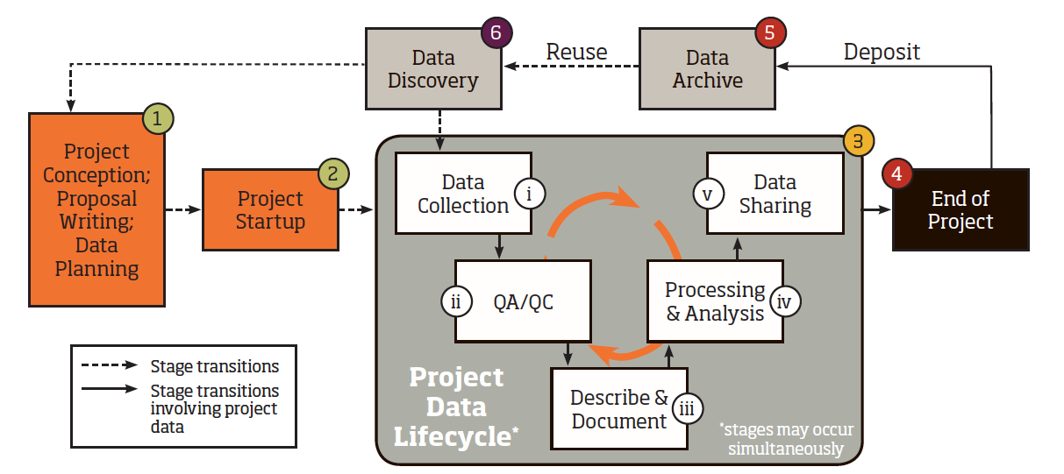
Landscape: Library Liaison in the research and data lifecycle at OHSU
Role for Liaison contact and Research Data Management
best practices support at each step
Whitmire, 2013
Notes:
DO IT FAST
I inhabit the Research and data life cycle right now
Traditionally, we have seen research as a linear process ending in planning to publication, but that’s over. It’s a cycle.
Data is reused and shared now. Repositories are required, increased data transparency is required.
Researchers need our help - so there is tremendous opportunity to embed library resources at each step here.
BUT- you’ve got to be willing to meet researchers where they are – and the relationship needs to be established so they realize the value of collaborating with us.

Slide 11
Landscape: Library Liaison in the research and data lifecycle at OHSU
Formal and informal project conception – relationship is key
Whitmire, 2013
Notes:
DO IT FAST
Step 1: project conception – this can be formal (as in a grant proposal and formal data management plan) or informal (hey, I want to do a pilot experiment on that new microscope)
For the formal, that’s an easy opportunity to provide in person support and materials.
For the informal, well, what if that new microscope is part of a core that requires or encourages a data management and storage plan for new users – rather than deleting our file every two weeks
Getting the informal project conception conversation going is a critical area for growth here at OHHU. With good relationships in place, we can be approachable and relevant at this critical initiation step.

Slide 12
Landscape: Library Liaison in the research and data lifecycle at OHSU
That’s why they call it RE-search
Whitmire, 2013
Notes:
Startup:
When the researcher starts a project, things often don’t process exactly on plan.
There’s an old joke: That’s why they call it RE-search, do it again.
During the initiation and troubleshooting phase of a project, the Library liaison can nimbly respond to the to the needs of the researcher as the type of data collected may change, or the scale of the data changes, or the project makes an unexpected pivot into data discovery

Slide 13
Landscape: Library Liaison in the research and data lifecycle at OHSU
Connection to best practices & resources throughout
data lifecycle
Whitmire, 2013
Notes:
This is where the RDM librarian can really connect researcher to best practices
But you’ll never see the inside of the data cycle without researcher involvement – which is unfortunate because they do need help here.
Data collection- immediately presents short term and long term storage issues
QA/QC – Quality Assurance/Control is a place for increased standardization, methodological transprency in increase reproducibility, and protocol development
Describe and document – Metadata –many researchers don’t understand how to create useful metadate for the multi-step experiments – they don’t know, we can help them.
We can help them learn the tools to create reproducible research reports and interactive figures,
We can help them select repositories, present data online through fig share or helping to prep data papers

Slide 14
Landscape: Library Liaison in the Research and Data Lifecycle at OHSU
What is the “End” you speak of?
Whitmire, 2013
Notes:
Many projects never really end.
Discrete publishable units are formed and published and the lab continues to build upon their earlier work.
But people do leave.
When a postdoc leaves a lab, RDM best practices education will ensure that all data is stored in an archival format, and this in conjunction with all the earlier planning and documentation steps willl ensure the lab, the lab’s collaborators, or the greater scientific community can build on the work - in six months or in six years.
It’s nice that there’s a roll for the Library at each of these steps, but how do we actually make it happen?

Slide 15
Challenges: Making data management services effective & wide reaching
Relationship Building
Liaison model creates a point of contact
Scientific domain knowledge
Understand and anticipate needs
Library domain knowledge
Notes:
What are the challenges to making RDM services effective and wide reaching?
Relationship building is a huge part of this job.
The liaison model creates a point of contact, and the groundwork is in place for library involvement in graduate programs and departments
Using my domain knowledge, and scientific training to get up to speed quickly with new methodologies, approaches, and research questions. I will be able to better understand and anticipate the needs to researchers and developing new ways for the library to connect.
But what I don’t have, is deep library domain knowledge. For example, Librarians are experts in going in and finding the root problem “Reference interview” – for me, developing skills like that in conjunction with my scientific knowledge and training will boost the reach of this position and enable me to be effective at understanding the root of researcher concerns and needs. In order to best market services like our digital repository to researchers, I need to understand more about how it is structured and what our priorities are - I will collaborate with you and learn from you to grow my librarian skill-set to become the an effective Basic Science Library liaison in the research community.

Slide 16

Vision: Basic Science Liaison & Research Data Management at OHSU
Position OHSU Library to anticipate and respond nimbly to needs of researchers at all levels
gettyimages.com
Notes:
Now, the vision.
By leveraging the resources of the library and developing new RDM programming, we can position…
I would have put a picture of a marathon runner being handed water to represent anticipation of needs, but this coffee hand-off is much more domain-specific
I care because I want to work for the future of science, and there is a real need for data management services at our institution. I have seen countless student and postdoc projects take longer than necessary, or need to be repeated due to a lack of good documentation, and lack of a data management plan.

Slide 17
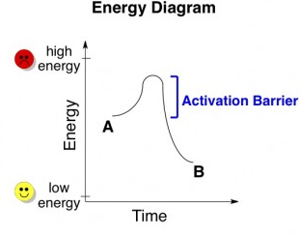
Vision: Basic Science Liaison & Research Data Management at OHSU
Remove the barrier to best practices
icanhasscience.com
Notes:
All of this can be distilled down futher: we have the ability to remove the energy barrier for best practices acorss the board. This graph is called an energy diagram. On the y axis we have energy low to high. As you travel form A to B, you need to add energy to get to B, even though B exists at a lower energy state. You can’t just roll down hill. The energy you need to add in to this reaction is called the energy or activation barrier,
Documenting your data to begin with! It’s a lot of work upfront, but I, as the RDM specialist am the catalyst to reduce the energy barrier
What we can do by anticipating the needs of reseaarcher and providing timely services and programming is reduce or remove the energy barrier to best practices.

Slide 18
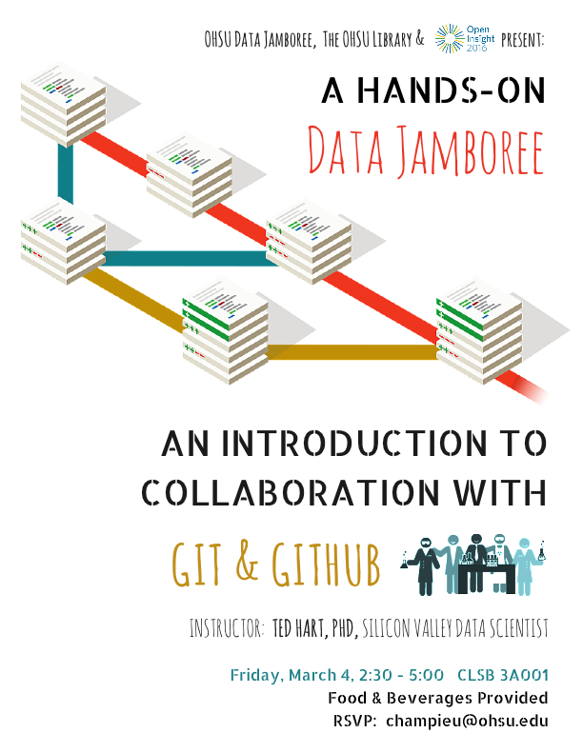
Case study: Workshops as point of contact for OHSU researchers
Notes:
~80 people
(reminder – they show up!)
PSU OHSU Intel,
Sometimes researchers don’t know what they need
Or they do know, but don’t ask for it
How many of you know what Git is? It is a collaborative program created by software developers BUT USED BY EVERYONE for all kinds of open projects, particularly collaborative or open source projects OPEN INSIGHT LOGO

Slide 19
Case study: Workshops as point of contact for OHSU researchers
“As a coding newbie, the workshop was very helpful and well organized - I felt comfortable learning a new skill”
-PhD Student
Notes:
This is a person with no programming experience at all, and no command line experience, who was able to type along with the workshop and GET THE CONCEPT. That’s digital literacy happening right before our eyes.

Slide 20
Case study: Workshops as point of contact for OHSU researchers
“As a coding newbie, the workshop was very helpful and well organized - I felt comfortable learning a new skill”
-PhD Student
“We were supposed to be using Mercurial, but we weren’t using it consistently, and then Git but not everyone knew it, so we kinda dropped all that stuff…”
-Sr. Lab Technician
Notes:
This is an example of a researcher who knew about the tool, but the energy barrier of getting everyone up to speed with the skills to use the tool got in the way, and the researcher defaulted to a less effiecint system

Slide 21
Case study: Workshops as point of contact for OHSU researchers
“As a coding newbie, the workshop was very helpful and well organized - I felt comfortable learning a new skill”
-PhD Student
“We were supposed to be using Mercurial, but we weren’t using it consistently, and then Git but not everyone knew it, so we kinda dropped all that stuff…”
-Sr. Lab Technician
“I’ve been emailing code back and forth with collaborators, students, and volunteers… It was getting crazy”
-Postdoc
Notes:
This is a classic case where a researcher didn’t know the tool and prioritized their science above research into better workflow – that’s fine, that’s their job – and our job to to step in with events like this

Slide 22
Case study: Workshops as point of contact for OHSU researchers
“As a coding newbie, the workshop was very helpful and well organized - I felt comfortable learning a new skill”
-PhD Student
“We were supposed to be using Mercurial, but we weren’t using it consistently, and then Git but not everyone knew it, so we kinda dropped all that stuff…”
-Sr. Lab Technician
“I’ve been emailing code back and forth with collaborators, students, and volunteers… It was getting crazy”
-Postdoc
“I’ve been meaning to do this”
-Faculty
Notes:
(sitting and working with her students)
Another example of someone who know about the tool, and in this case possessed some of the skills, but needed a workshop setting to reserve the time to make it happen

Slide 23
Case study: Workshops as point of contact for OHSU researchers
Needs identified through workshop:
Basic skills
Command line
Programming literacy
Advanced skills
R Markdown/Knitr & iPython notebook
Software & Data Carpentry
Immediately actionable, timely
All levels of researchers
Small time investment for participants
Notes:
Beyond good quotes, Robin myself, and the rest of the Open Insight team got immediate feedback at the event which could be basically broken down into basic skills like cLI and Basic programming (exists currently online) and more advanced skills/ longer/deeper dives like rMarkdown and Softwre/data carpentry which are full weekend events

Slide 24
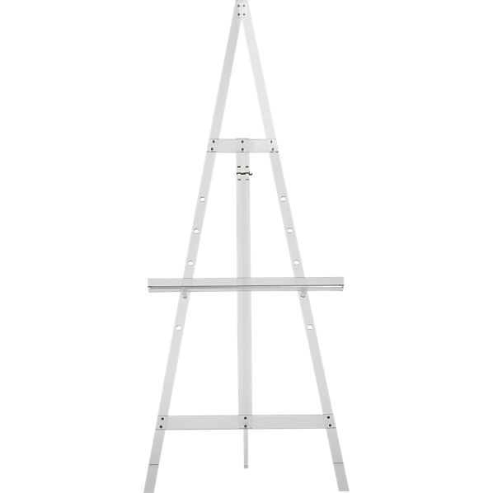
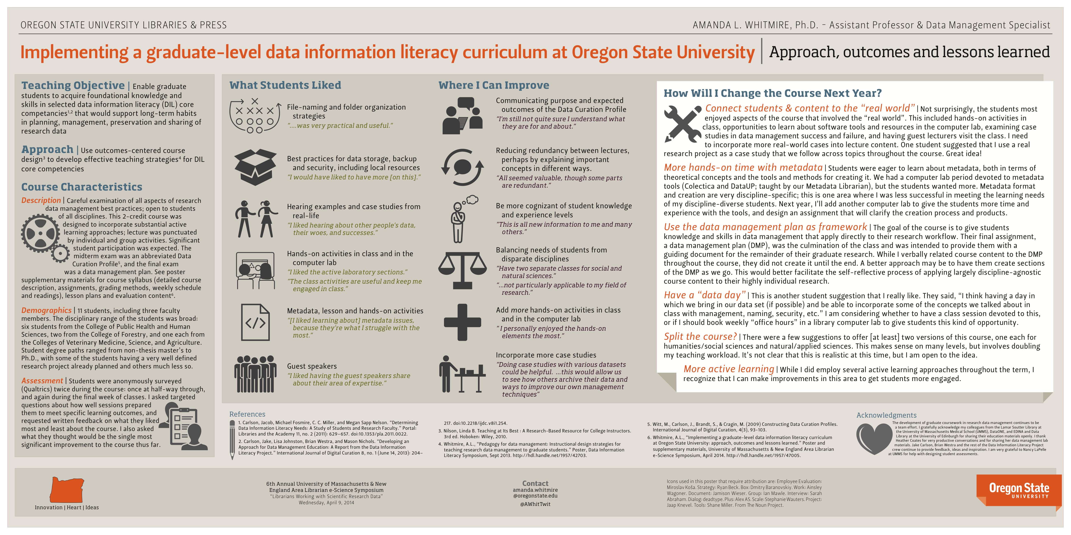
Case study: Formalized research data management course at OSU
Graduate credit-bearing course
(Whitmire 2014, 2015)
Outcomes-centered design
DIL core competencies
Long-term behavioral change
Develop OHSU curriculum
Specific to our researchers
Relevant to their data
Supplement with skill-building workshops
Develop “deep, transferrable understanding” (Carlson et al. 2013)
Notes:
Lots of resources out there – take it make is perfect for OHSU researchers speciically! We are focused in biomedical and lots of basic science
Need curriculum specific to our population
….and relevant to their data
Supplement with skill-building workshops
Courses
Suplemented by workshops and clincs
Capatalize on the strengths of each format
Cirriculum vs hands on
Learn the skills to use the best tools
Remove the energy barrier

Slide 25
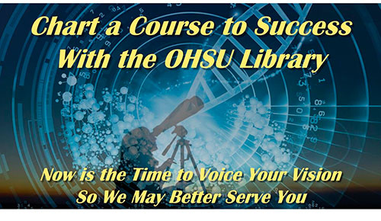
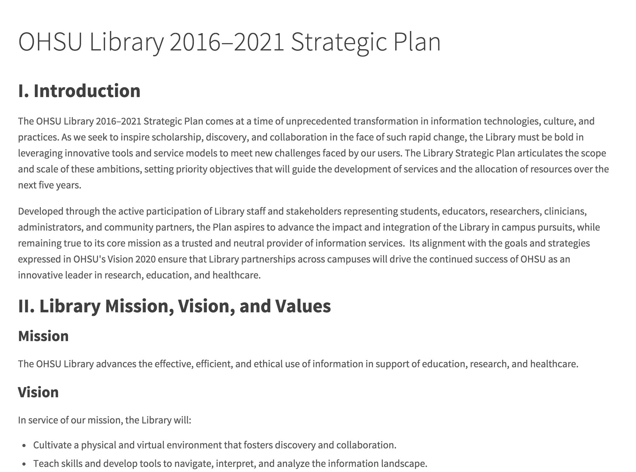
OHSU Library Strategic Plan:
Priorities informed by stakeholders
www.ohsu.edu/xd/education/library/2016-2021-strategic-plan.cfm
Notes:
CHART A COURSE! I know the library has just gone though startegic planning, and I was excited to PARTICIPATE and to see the strategic plan posted because it lays out Library priorities and I’ll use that as direction in how to roll out my objective

Slide 26
Action Plan: Basic Science Liaison & Research Data Management at OHSU
1. Relationship building
Connect, collaborate to understand & meet stakeholder needs
2. Research data management services
Data literacy across research lifecycle
3. Educational Programming
Develop, deliver, evaluate outcomes
www.ohsu.edu/xd/education/library/2016-2021-strategic-plan.cfm
Notes:
, via instruction, educational materials, and advancement of best practices (2.3)
of formal education programs (3)

Slide 27
Action Plan: Basic Science Liaison & Research Data Management at OHSU
1. Relationship building
Immediately leverage knowledge of researcher needs
Multi-level PhD program outreach (faculty, students)
Courses, workshops & skill clinics (all levels)
Data management support for labs, grants (all levels)
Library Liaison position on committees Voice perspective, promote library services (faculty)
Collaborate with Library Liaisons and Library faculty
Workshop & develop outreach, assessment mechanisms
Notes:
As with any relationship, the HOW is more complicated. As I have discussed, we have researcher at all levels cycling through our labs, and they’re constantly innovating! So they’re busy.
In this position, I will be able to immediately leverage knwledge of researcher needs - If we can come to the table with a deep understanind of faculty and researcher needs, we can expect greater participation
For example, I can go to the PhD program retreats and speak about issues that matter to students or lead a workshop – this is a time for faculty and students to relax and connect and this the perfect place to promote library services. We can also partner with faculty to develop courses using the nano format to reach students. Workshops and skill clinics attract researcher at all levels, especially if we make the content specific to our unique needs, and stay mindful of researcher time.
We can promote data management support for grants through grants office, and
We can seek library faculty representation on PhD program comittees, research week, as well as higher level institutional committees
These are the realtionships that will guide the depeopment of resources, inform the creation of educational programming, and inform policy at the library, departmental, and instutional level
And – I am still a researcher - so I will also inititate data collection to describe and assess the current OHSUresearcher knowedge and culture around data and library services.
Deep understanding of diversity of faculty/researcher needs
Guides Liaison connection of researcher to Library resource
Builds trust & confidence
Stakeholder-informed resources, programs, policy

Slide 28
Action Plan: Basic Science Liaison & Research Data Management at OHSU
1. Relationship building
Connect, collaborate to understand & meet stakeholder needs
2. Research data management services
Data literacy across research lifecycle
3. Educational Programming
Develop, deliver, evaluate outcomes
www.ohsu.edu/xd/education/library/2016-2021-strategic-plan.cfm
Notes:
, via instruction, educational materials, and advancement of best practices (2.3)
of formal education programs (3)

Slide 29
Action Plan: Basic Science Liaison & Research Data Management at OHSU
2. Research data management services
Highlight research data management best practices
Collaboration & innovation (all levels)
Efficient project transitions (faculty)
Improve current workflow, boost productivity (students)
Develop credit-bearing nanocourse (students)
Develop, deliver, assess
Initiate assessment “State of the Data” at OHSU
Collaborate with library, faculty, core labs, institutes
Notes:
How to we roll out RDM services, I can hang up a shingle (on the internet) but that doesn’t mean anyone will come. Active outreach to develop and leverage relationships is the only way to make this happen – we have the carrots, the funding agencies have the sticks, and we can try to make their sticks look like carrots….
We will need to leverage relationships to Tailor the message for faculty, staff, postdocs and students
Promote data literacy across the research lifecycle through instruction, educational materials, and advancement of best practices
Map State of the Data at OHSU
Reference interview
Providing stakeholder-driven RDM services will support….
Collaboration & innovation, efficient project transitions
Diverse outputs with appropriate data management practices
Develop services that support diverse data outputs with appropriate data management practices
Develop assessment mechanism to track
Assess the culture of data management at OHSU
OCTRI assessment based on confidence – adrian rodgers

Slide 30
Action Plan: Basic Science Liaison & Research Data Management at OHSU
1. Relationship building
Connect, collaborate to understand & meet stakeholder needs
2. Research data management services
Data literacy across research lifecycle
3. Educational Programming
Develop, deliver, evaluate outcomes
www.ohsu.edu/xd/education/library/2016-2021-strategic-plan.cfm
Notes:
, via instruction, educational materials, and advancement of best practices (2.3)
of formal education programs (3)

Slide 31
Action Plan: Basic Science Liaison & Research Data Management at OHSU
3. Educational Programming
Immediate follow-up Open Insight Series
Basic skills & advanced skills support
Development of Research Data Management course
Specific to needs/data of OHSU researchers
Graduate training is changing/evolving!
New opportunities for Library involvement in graduate course development, instruction, assessment
Notes:
How to we roll out RDM services, I can hang up a shingle (on the internet) but that doesn’t mean anyone will come. Active outreach to develop and leverage relationships is the only way to make this happen – we have the carrots, the funding agencies have the sticks, and we can try to make their sticks look like carrots….
We will need to leverage relationships to Tailor the message for faculty, staff, postdocs and students
Promote data literacy across the research lifecycle through instruction, educational materials, and advancement of best practices
Map State of the Data at OHSU
Reference interview
Providing stakeholder-driven RDM services will support….
Collaboration & innovation, efficient project transitions
Diverse outputs with appropriate data management practices
Develop services that support diverse data outputs with appropriate data management practices
Develop assessment mechanism to track
Assess the culture of data management at OHSU
OCTRI assessment based on confidence – adrian rodgers

Slide 32
Building Data-Centric Relationships with Researchers at OHSU
“An engaged liaison seeks to enhance scholar productivity, to empower learners, and to participate in the entire lifecycle of the research, teaching, and learning process.”
Jaguszewski & Williams, 2013
Notes:
Uniquely quailified to hit the ground running in the position
1. Relationship building
Connect, collaborate to understand & meet stakeholder needs
2. Research data management services
Data literacy across research lifecycle
3. Educational Programming
Develop, deliver, evaluate outcomes

Slide 33
Citations
Briney, K., Goben, A. & Zilinski, L., (2015). Do You Have an Institutional Data Policy? A Review of the Current Landscape of Library Data Services and Institutional Data Policies. Journal of Librarianship and Scholarly Communication. 3(2), p.eP1232. doi: http://doi.org/10.7710/2162-3309.1232
Carlson, J., Fosmire, M., Miller, C., & Sapp Nelson, M. (2011). Determining data information literacy needs: A study of students and research faculty. portal: Libraries and the Academy, 11(2), 629-657.
Carlson, J., Johnston, L., Westra, B., & Nichols, M. (2013). Developing an approach for data management education: A report from the data information literacy project. International Journal of Digital Curation, 8(1). 204-217. doi:10.2218/ijdc.v8i1.254
Dyke, S., & Hubbard T., (2011). Developing and implementing an institute-wide data sharing policy. Genome Med.; 3(9): 60. doi: 10.1186/gm276
Provost’s Task Force on the Stewardship of Digital Research Data. “Research Data Stewardship at UNC: Recommendations for Scholarly Practice and Leadership”. Chapel Hill, NC, 2012.
Rolando, L., Carlson, J., Hswe, P., Parham, S. W., Westra, B. and Whitmire, A. L. (2015), Data Management Plans as a Research Tool. Bul. Am. Soc. Info. Sci. Tech., 41: 43–45. doi: 10.1002/bult.2015.1720410510
Shaffer, Christopher J.. (2013). The Role of the Library in the Research Enterprise. Journal of eScience Librarianship 2(1): Article 4. http://dx.doi.org/10.7191/jeslib.2013.1043
Whitmire, A.L., (2013): Data management throughout the research lifecycle. Figshare.https://dx.doi.org/10.6084/m9.figshare.774628.v2
Whitmire, A.L.,(2014) Implementing a graduate-level data information literacy curriculum at Oregon State University: approach, outcomes and lessons learned. Poster, University of Massachusetts & New England Area Librarian e-Science Symposium. http://hdl.handle.net/1957/47005
Whitmire, A. L. (2015). Implementing a Graduate-Level Research Data Management Course: Approach, Outcomes, and Lessons Learned. Journal of Librarianship and Scholarly Communication, 3(2), eP1246. doi:10.7710/2162-3309.1246
Notes:
Uniquely quailified to hit the ground running in the position

Slide 34
Questions?
Thank you to Stephanie Kerns and the search committee members!
Email: robidani@ohsu.edu
Special thanks to…
Heather Coates, MLS MS (IUPUI)
Amanda Whitmire, PhD (Stanford)
Carrie Iwema, MLS PhD (Pitt)
Stephanie Wright, MLS (Mozilla Labs, formerly UW)
…for great conversations that have helped me to better understand the role of data management librarianship in the library landscape.
Notes:
Uniquely quailified to hit the ground running in the position

Slide 36
Connect, collaborate to understand & meet stakeholder needs

Slide 37
Action Plan: Basic Science Liaison & Research Data Management at OHSU
Research data management services
Values: Collaboration, Innovation, Diversity, Research, Knowledge, and Integrity
Goals: Promote data literacy across research lifecycle via instruction, educational materials, and advancement of best practices (2.3)
Assist navigation of diverse policies and reqs related to data and other scholarly products (2.5)
www.ohsu.edu/xd/education/library/2016-2021-strategic-plan.cfm
Notes:
Promote data literacy across the research lifecycle through instruction, educational materials, and advancement of best practices
Reference interview

Slide 38
Action Plan: Basic Science Liaison & Research Data Management at OHSU
Educational Programming
Values: Collaboration, Innovation, Diversity, Research, Knowledge, Integrity
Goals: Engage in development, delivery, & evaluation of formal education programs (3)
Leverage relationships to bring new paradigms and practices directly into curricula (3.2)
Develop formal mechanisms to evaluate quality, impact of Library educational programs (3.6)
Researcher perspective
Sometimes researchers don’t know what they need
Or they know, but don’t ask for it
Notes:
Reference interview

Slide 39
Action Plan: Basic Science Liaison & Research Data Management at OHSU
Educational Programming
Sometimes researchers don’t know what they need
Or they know, but don’t ask for it
Build relationships
Understand research landscape
Anticipate needs
Nimbly respond with timely educational programming
Notes:
Reference interview

Slide 40
Landscape: Research data management & liaison services
Liaison Librarian
Point of contact support
Connecting clients with resources
Providing instructional support
Research Data Management
Data literacy training
Data management plans
Connect researchers with tools to meet funder’s requests
Collaborate at institutional level on policies that affect data sharing and management

Slide 41
in terms of junior personelle – we attract fantastic students and postdocs - and they’re all going to come here with different habits, skills, and RDM sytems.
In any given month, a lab could have a rotation student leave, a postdoc start, an undergrad volunteer continue their project – this is how research gets done.
They’re here to work with our amazing faculty, but I know firsthand that RDM strategies are incredibly variable acorss campus.
And this diversity of approaches has to do with Faculty personal history, knowelgdes of resources, and BP, as well as their specific funding and funder requirements.

Slide 42
Vision: Basic Science Liaison & Research Data Management at OHSU
Position OHSU Library to anticipate and respond nimbly to needs of researchers at all levels
Build relationships
Educational programming & skill building clinics
Research data management instruction and consulting
Library voice in institutional policy
Scholarship and collaboration
Notes:
CUT THIS
What does it mean to anticipate and respond nimbly?
First we maintain and build relationships
Though those relationships, we develop relevant and timely educational programming and clinics/workshops
we facilitate RDM though best practices instruction and one-on-one consulting
we engage at a higer level, we are the RDM experts and can speak for best practices at the level of institutional policy
And finally, I will always be a researcher at heart, so I want to keep doing hypothesis driven research though internal and external collaborations
Higher level stuff -Data science policy
Witig lib and externally and researchers

